Slide 1
Online Food Delivery System
By:
Team lead: Namrata Balaso Phalke - 2486988
Members: Mosha Anilkumar Reddy - 2484551
Mukilan S - 2484927
Nakkala Ashok - 2485098
Nandini X - 2486868
Pallavi Mahadeo Atram - 2487678
Pandre Meghna - 2484025
Poluboina Kalpana - 2486689
Pratiksha Shivanand Naik - 2484046
Pruthwik B S - 2486278

Slide 2
TOPICS TO BE COVERED
Abstract
Introduction
Technology Used
Flowchart
Results
Conclusion

Slide 3
ABSTRACT
Online Food Delivery System is a website designed mainly for use in food delivery.
The System shows an user interface and update the menu with all available options so that it ease the customers work.
Customer can choose more than one item to make an order and view the order details before logging off.
The order is placed in the queue and updated in the database and returned in the real time.

Slide 4
INTRODUCTION
Foodbox is an online food delivery web application for ordering food items of different cuisines.
Foodbox is a restaurant chain that delivers food items of different cuisines at affordable prices.
It is not just about flexibility , it’s about protecting the customer base by staying connected with them.
The best food ordering apps around the globe are Swiggy and Zomato, which have made the food ordering and delivery marketplace encouraging with ideas.

Slide 5
TECHNOLOGY USED
Front End:
HTML, CSS and Bootsrap4
TypeScript: Angular/ NodeJS
GitHub
Back End:
SpringBoot, Hibernate, MySQL
Postman

Slide 6
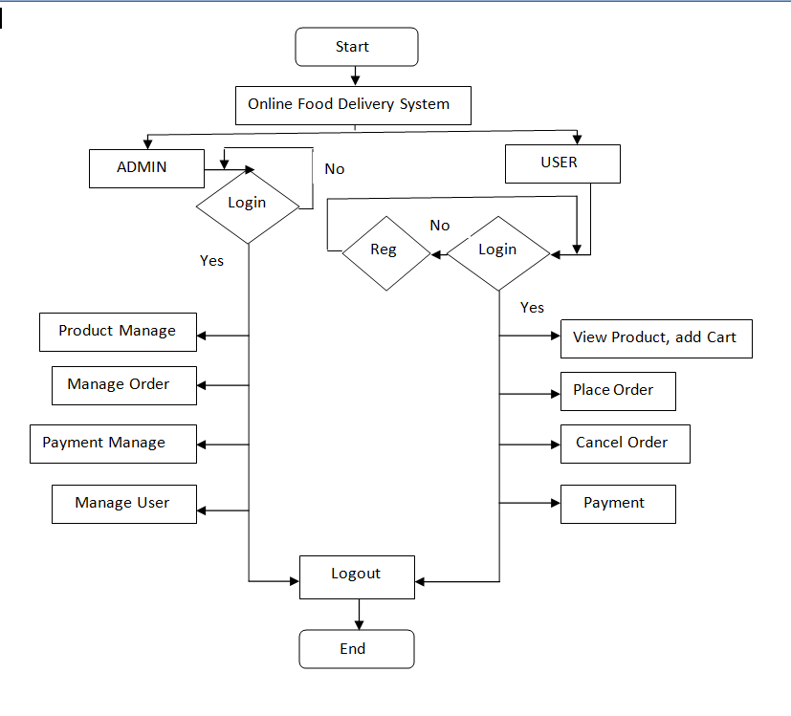
FLOW DIAGRAM

Slide 7
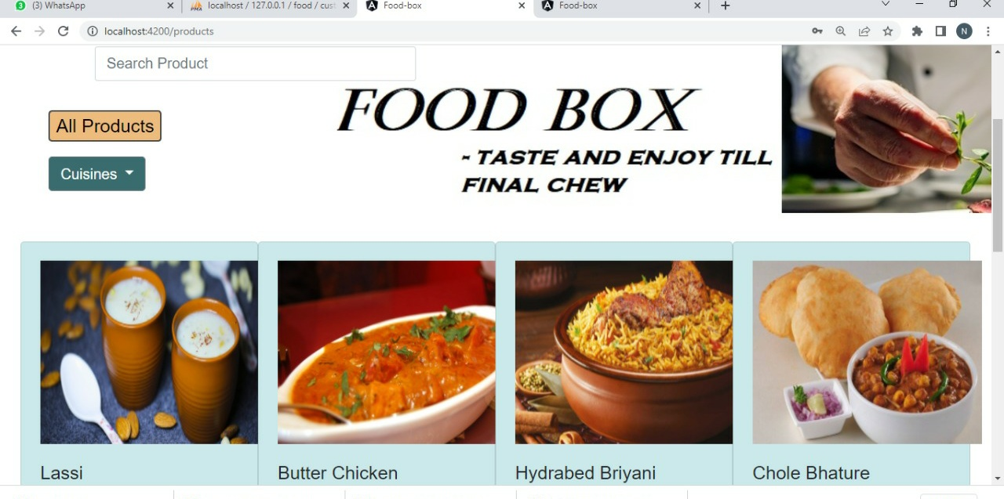
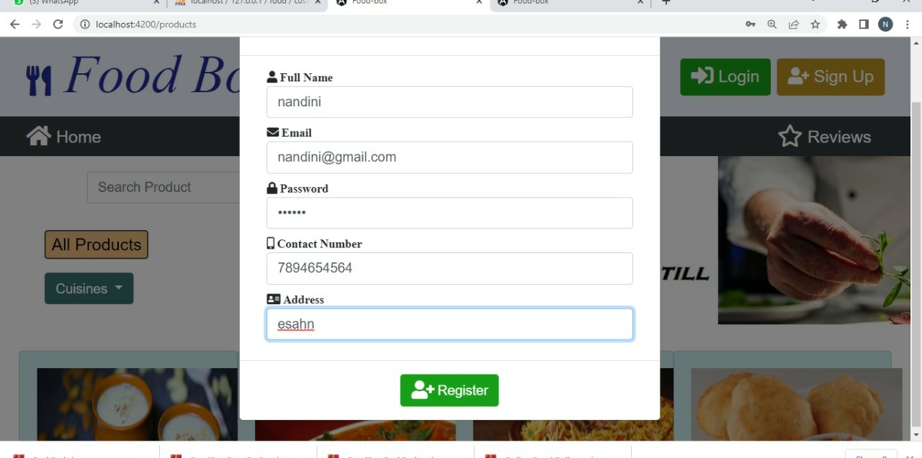
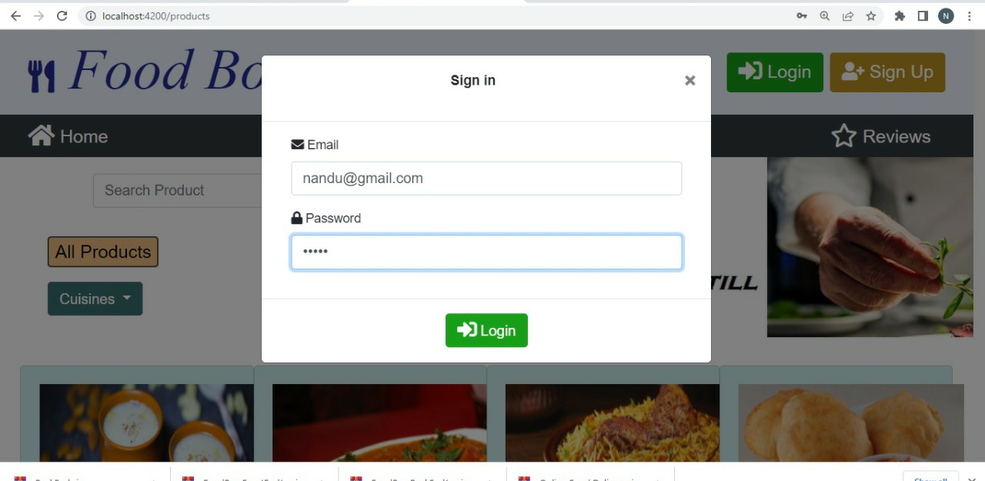
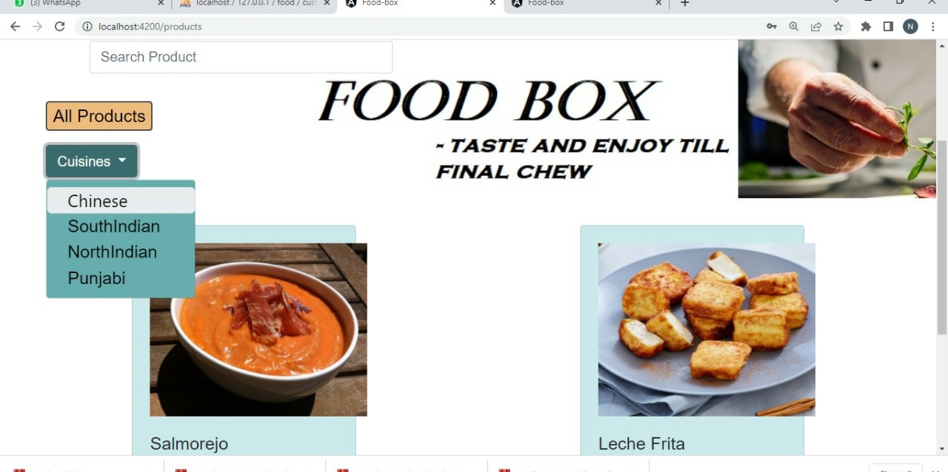
RESULTS Application Screenshots Home Page Registration Page Sign In Page Searching for Cuisines

Slide 8
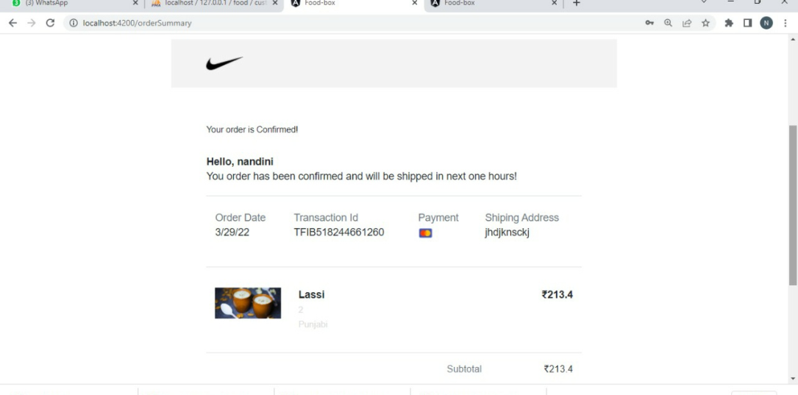
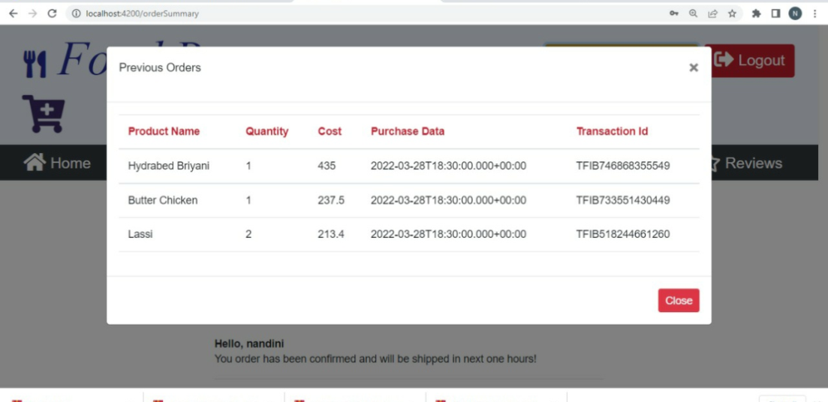
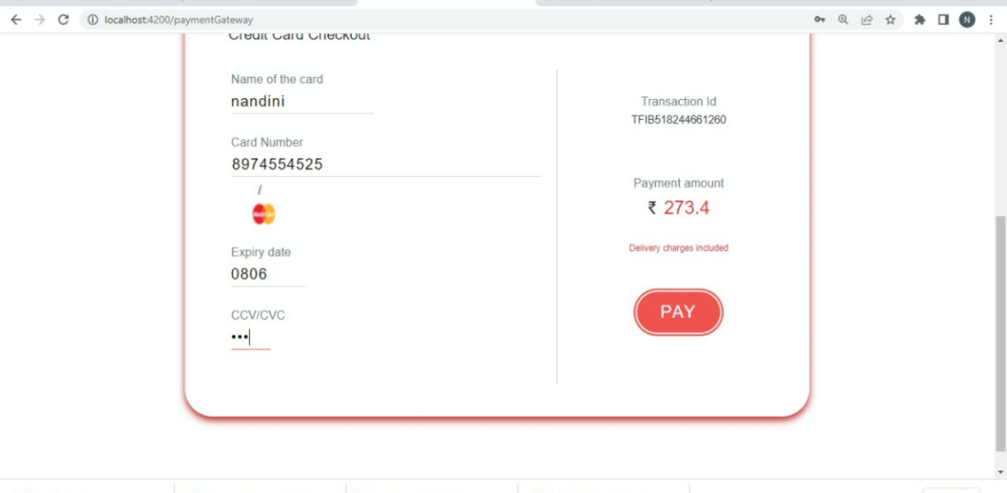
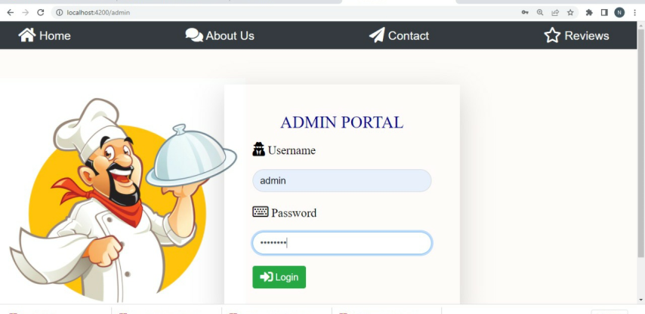
RESULTS Application Screenshots Order Confirm Previous Orders Payment Page Admin Login

Slide 9
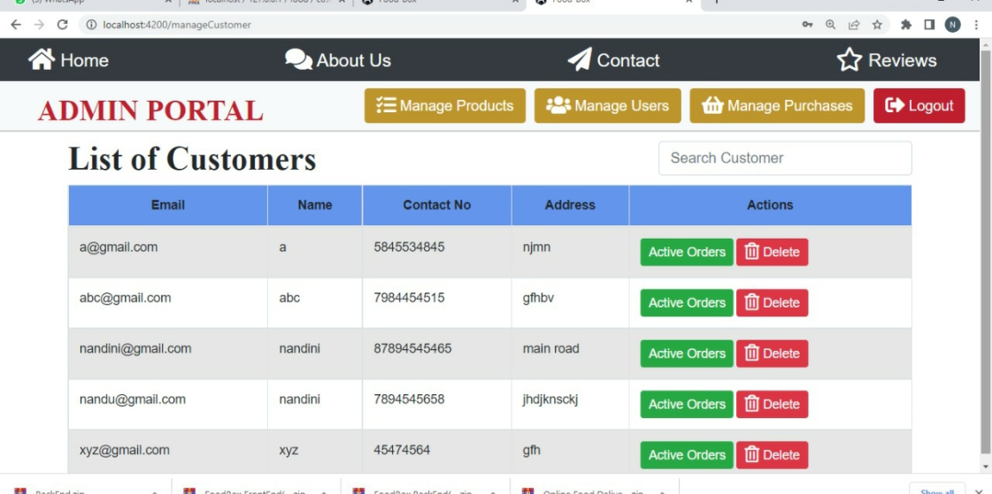
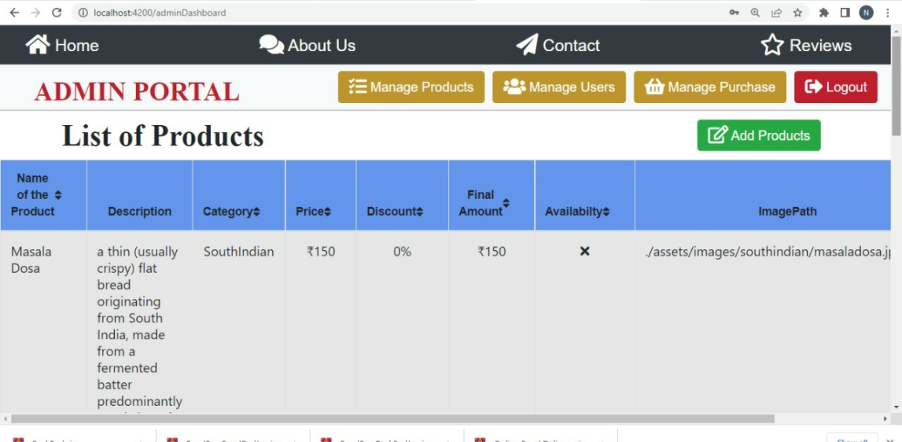
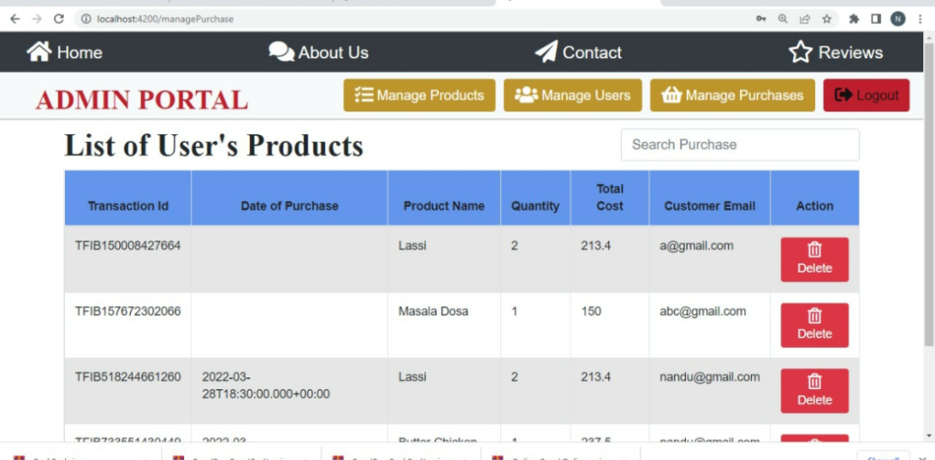
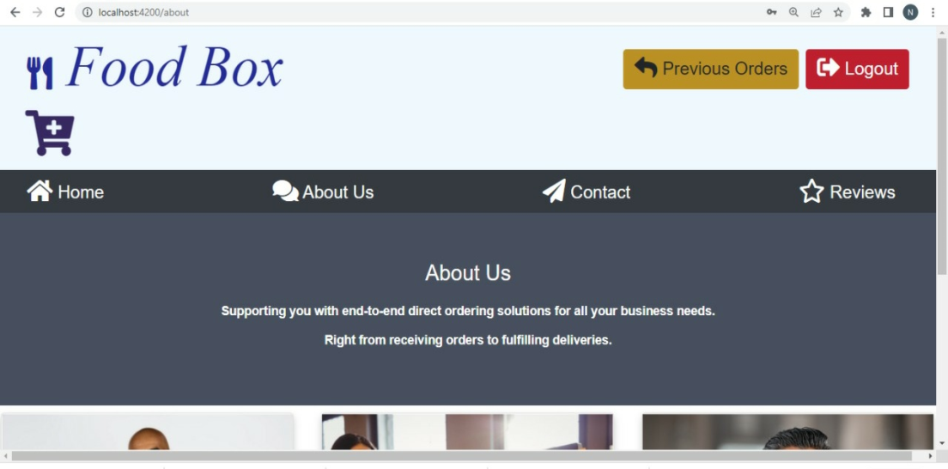
RESULTS Application Screenshots Manage Customers Manage Products Manage User’s Products About Us Page

Slide 10
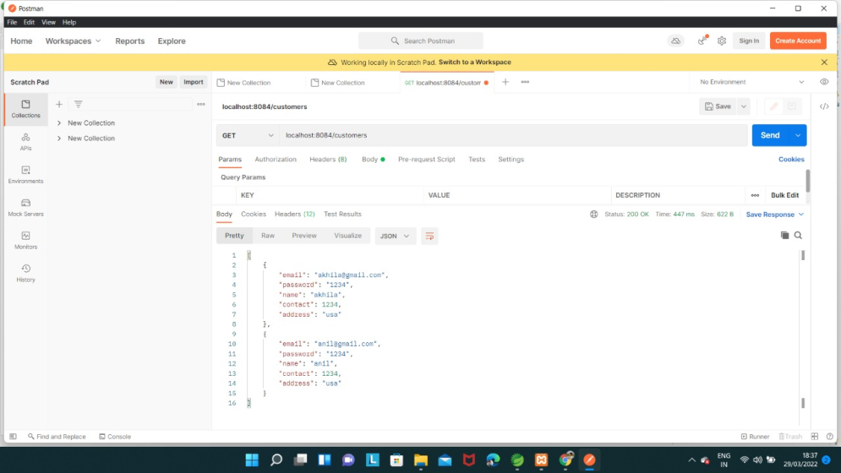
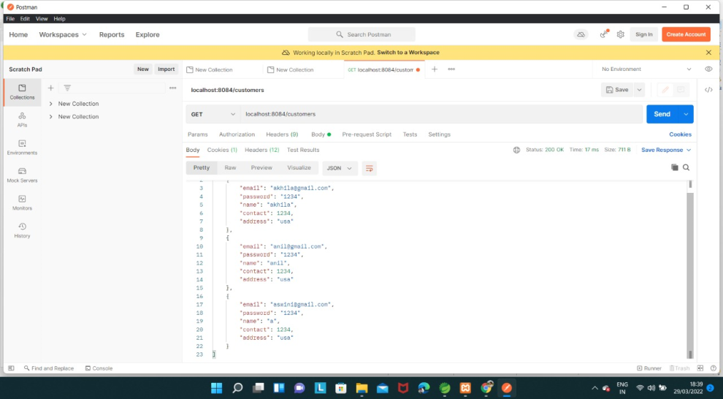
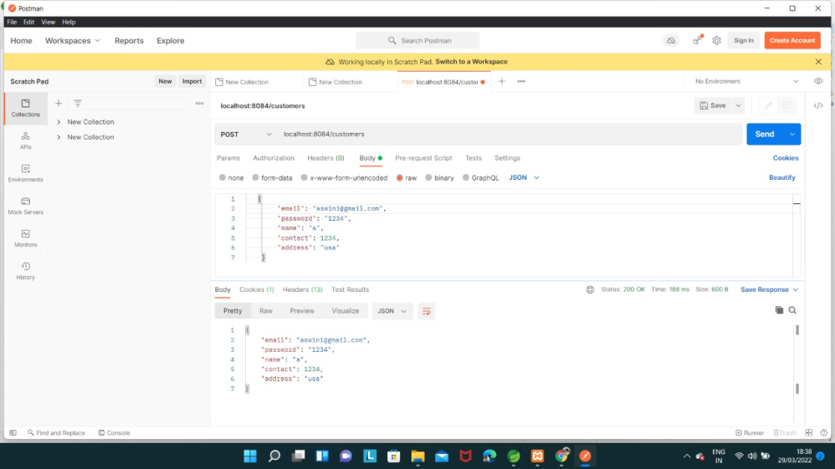
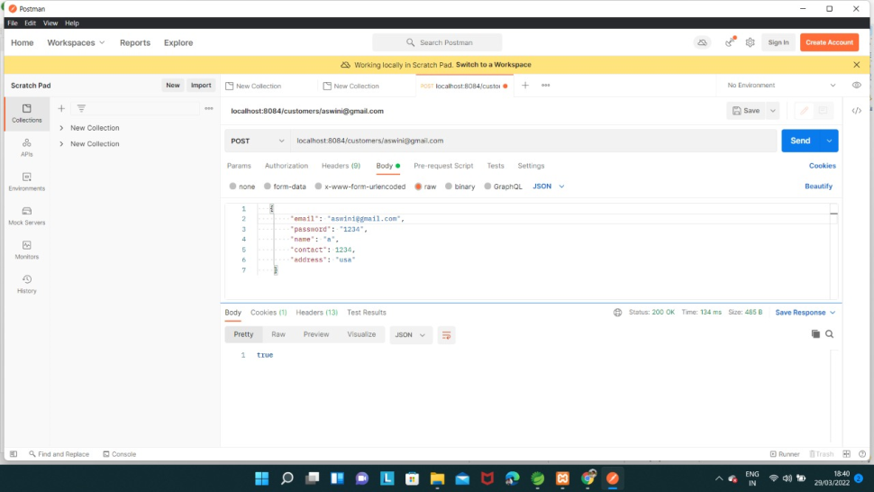
RESULTS Postman Functional Testing

Slide 11
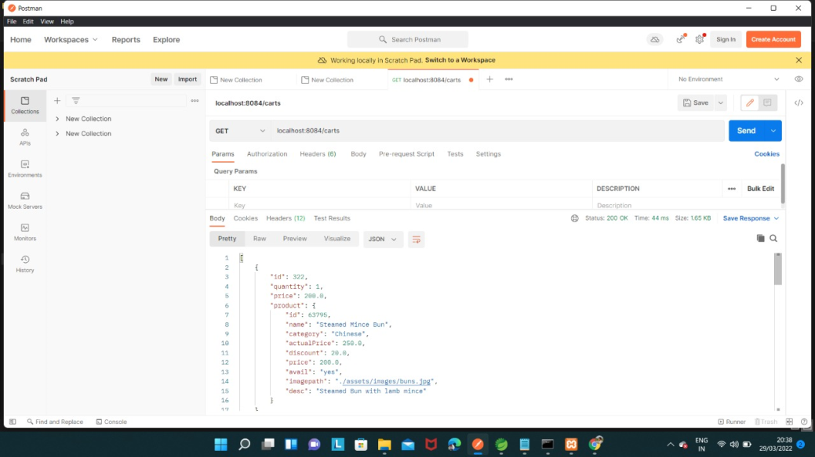
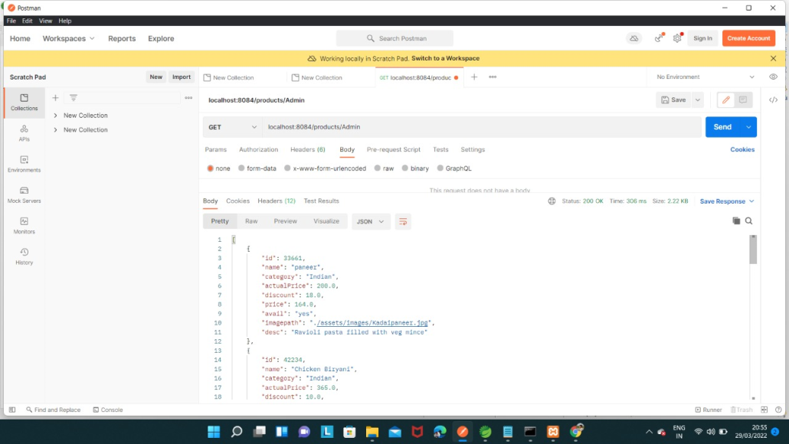
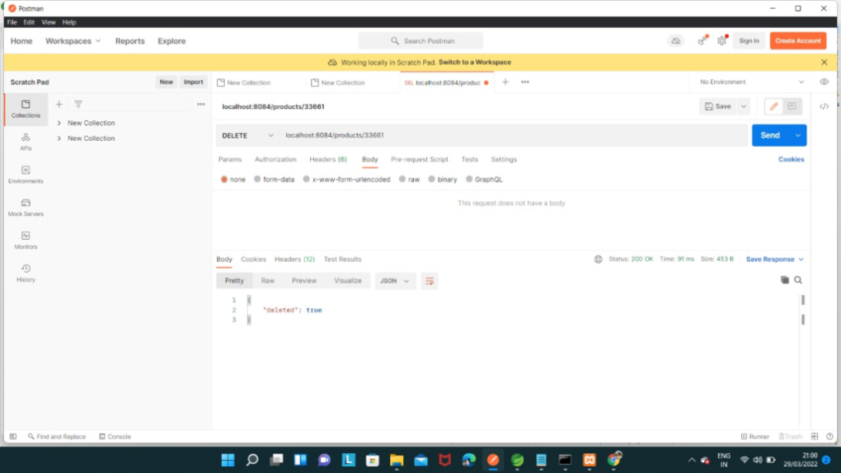
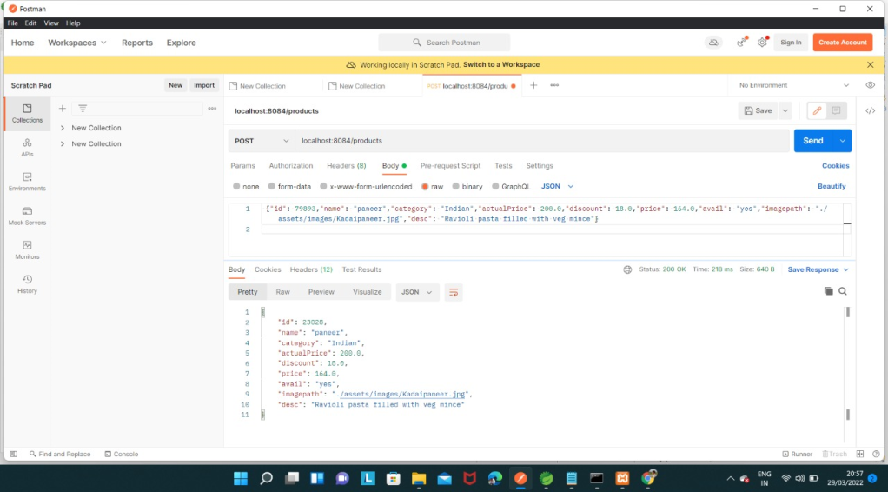
RESULTS Postman Functional Testing

Slide 12
CONCLUSION
An Online Food Delivery System is developed where the customers can make an order for the food and avoid the hassels of waiting for the order taken by waiter.
In this application, end users register online, read the menu and select the food from the menu to order food online.
Once customer selects the food item the chef will be able to see the results and start processing the food.
The main objective here is to provide easy and secure platform for Ordering Food and maintain records of Product, Category available in the system

Slide 13
THANK YOU…

